Slide 1
Garden of Eden - Record from the Sumerian Nippur Library - The Kharsag Tablets Edmund Marriage Extract from Learning from History Part 16 Delving deeper into the detailed evidence to add knowledge to my previous presentations www.goldenageproject.org.uk Copyright – Patrick Foundation

Slide 2
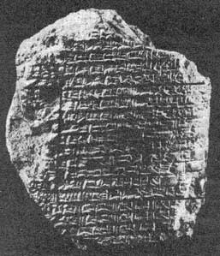
MAN'S GOLDEN AGE
This tablet (29.16.422 in the Nippur collection of the University Museum) is one of the unpublished pieces belonging to the Sumerian epic poem whose hero Enmerkar ruled in the city of Ereck sometime during the fourth millennium BC. The passage enclosed by the black line describes the blissful and unrivalled state of man in an era of universal peace before he had learned to know fear and before the "confusion of tongues"; its contents, which are very reminiscent of Genesis XI:1, read as follows:
In those days there was no snake, there was no scorpion, there was no hyena, There was no lion, there was no wild dog, no wolf, There was no fear, no terror, Man had no rival.
In those days the land Shubur (East), the place of plenty, of righteous decrees, Harmony-tongued Sumer (South), the great land of the "decrees of princeship", Uri (North), the land having all that is needful, The land Martu (West), resting in security, The whole universe, the people in unison, The Enlil in one tongue gave praise.
From Sumerian Mythology by Samuel Noah Kramer.

Slide 3
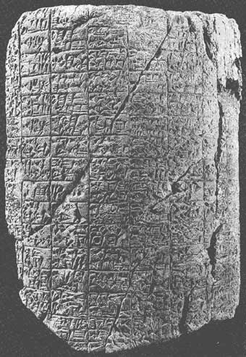
Archaic Tablet 8383
Nippur Archaic Cylinder
To judge from the script, the Nippur cylinder illustrated on this plate (8383 in the Nippur collection of the University Museum) may date as early as 2500 BC. Although copied and published by the late George Barton as early as 1918, its contents, which centre about the Sumerian air-god Enhil and the goddess Ninhursag, are still largely unintelligible.
Nevertheless, much that was unknown or misunderstood at the time of its publication is now gradually becoming clarified, and there is good reason to hope that the not too distant future will see the better part of its contents ready for translation.
From Sumerian Mythology by Samuel Noah Kramer.

Slide 4
Oxford University have classified the secular tablets translated by Christian O’Brien as fragments or versions of Oxford University established myths. In their most basic form all clearly have descriptions of the creation of an irrigated garden or agricultural settlement at the head of the valleys, and not incantations and hymns as suggested by the Revered Professor George Barton in 1918. Nippur Library Cuneiform Tablet numbers and descriptions below are held by the Museum of the University of Pennsylvania

Slide 5
Modern Title Museum Nos Barton’s Titles O’Brien Titles Debate between 14,005 A creation Myth Decision to Settle Sheep and Grain Barton Cylinder 8,383 The Oldest Religious Arrival of the Anannage Text from Babylonia Enlil and Ninlil 9,205 Enlil and Ninlil Romance of Enlil and Ninlil Self Praise of 11,065 A Hymn to Dungi Planning of the Cultivation Shulgi (Shugli D) Old Babylonia Oracle 8,322 An Old Babylonia Oracle Building of the Settlement Kesh Temple Hymn 8,384 Fragment - Liturgy to Nimrud Great House of Enlil Debate between 8,310 Hymn to Ibbi-Sin Cold Winter Storm Winter and Summer Hymn to Enlil 8,317 Excerpt from Exorcism Thousand Year Storm Lament for Ur 19,751, 2,204 Prayer to City of UR Final Destruction of 2,270, 2,302 Kharsag
:

Slide 6
Paul Bedson Research and Wikipedia Entries
I did extensive work on Wikipedia with the Barton tablets. They aren’t lost, just the content ignored. I created pages on every one. The problem is that the Barton tablets are now classified as fragments or versions of Oxford University established myths.
The importance of the establishment’s myths, translated according to religious biased standards, by religiously biased institutions, has superseded the importance or differences in the tablets themselves.
This is the problem with an academic establishment focussed on categorizing and filing, rather than understanding of the meanings.
The links to the pages about the tablets are below. When I wrote them, despite Wikipedia’s encyclopaedic requirements, I wanted to highlight their featuring Hursag - The garden of the gods and any geographical or physical features of the location of the myths.

Slide 7
References to Hursag or Kharsag - Wikipedia
Hursag (transcribed cuneiform: ḫur.saḡ (HUR.SAG)) is a Sumerian term variously translated as meaning "mountain", "hill", "foothills" or "piedmont".^{[1]}
Thorkild Jacobsen extrapolated the translation in his later career to mean literally, "head of the valleys".^{[2]}
Mountains play a certain role in Mesopotamian mythology and Assyro-Babylonian religion, associated with deities such as Anu, Enlil, Enki and Ninhursag.^{[citation needed]}
Some scholars also identify hursag with an undefined mountain range or strip of raised land outside the plain of Mesopotamia.^{[3][4]}

Slide 8
Ninurta Myth - Lugal-e describes the abundance of the Hursag - Wikipedia
In a myth variously entitled by Samuel Noah Kramer as “The Deeds and Exploits of Ninurta” and later Ninurta Myth Lugal-e by Thorkild Jacobsen, Hursag is described as a mound of stones constructed by Ninurta after his defeat of a demon called Asag. Ninurta’s mother Ninlil visits the location after this great victory. In return for her love and loyalty, Ninurta gives Ninlil the hursag as a gift. Her name is consequentially changed from Ninlil to Ninhursag, or the “mistress of the Hursag”.^{5][6]}

Slide 9
Ninurta Myth continued
The hursag is described here in a clear cultural myth as a high wall, levee, dam or flood-bank, used to restrain the excess mountain waters and floods caused by the melting snow and spring rain.
The hursag is constructed with Ninurta's skills in irrigation engineering and employed to improve the agriculture of the surrounding lands, farms and gardens where the water had previously been wasted.^{[6]}:

Slide 10
Debate between Sheep and Grain - Wikipedia
Another Sumerian creation myth, the Debate between sheep and grain opens with a location "the hill of heaven and earth", and describes various agricultural developments in a pastoral setting. This is discussed by Edward Chiera as "not a poetical name for the earth, but the dwelling place of the gods, situated at the point where the heavens rest upon the earth. It is there that mankind had their first habitat, and there the Babylonian Garden of Eden is to be placed."^{[88]} The Sumerian word Edin, means "steppe" or "plain",^{[89]} so modern scholarship has abandoned the use of the phrase "Babylonian Garden of Eden" as it has become clear the "Garden of Eden" was a later concept

Slide 11
List of additional supporting Ancient Texts
In the Kesh temple hymn, the first recorded description (c. 2,600 BC) of a domain of the gods is a garden - The four corners of heaven became green for Enlil like a garden."^{[60]}
In an earlier translation of this myth by George Aaron Barton in Miscellaneous Babylonian Inscriptions he considered it to read - "In hursag the garden of the gods were green."^{[82]}

Slide 12
Hymn to Enlil - Wikipedia
A Hymn to Enlil praises the leader of the Sumerian pantheon in the following terms:
You founded it in the Dur-an-ki, in the middle of the four quarters of the earth. Its soil is the life of the Land, and the life of all the foreign countries. Its brickwork is red gold, its foundation is lapis lazuli. You made it glisten on high.^{[91]}

Slide 13
Epic of Gilgamesh - Wikipedia
The Epic of Gilgamesh describes Gilgamesh travelling to a wondrous garden of the gods that is the source of a river, next to a mountain covered in cedars, and references a "plant of life". In the myth, paradise is identified as the place where the deified Sumerian hero of the flood, Utnapishtim (Ziusudra), was taken by the gods to live forever. Once in the garden of the gods, Gilgamesh finds all sorts of precious stones, similar to Genesis 2:12:
There was a garden of the gods: all round him stood bushes bearing gems ... fruit of carnelian with the vine hanging from it, beautiful to look at; lapis lazuli leaves hung thick with fruit, sweet to see ... rare stones, agate and pearls from out the sea.^{[90]}

Slide 14
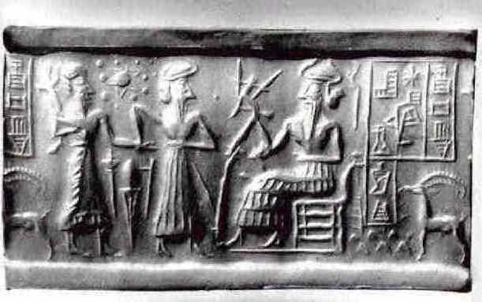
Song of the Hoe
The Song of the hoe features Enlil creating mankind with a hoe and the Annanuki spreading outward from the original garden of the gods. It also mentions the Abzu being built in Eridu.^{[60]} The Abzu is now defined as underground water or God’s Garden.
Cylinder seal Va243 which resides in a Berlin museum – Enlil holding the Plough

Slide 15
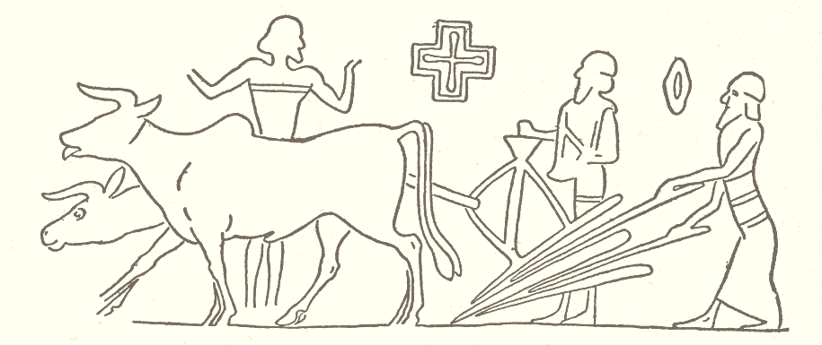
Seeder Plough Below - cylinder-seal impression on Nippur tablet 4,000 BC

Slide 16
Kesh temple (temon) hymn - Wikipedia
In the Kesh temple hymn, the first recorded description (c. 2,600 BC) of a domain of the gods is a garden - The four corners of heaven became green for Enlil like a garden."^{[60]}
In an earlier translation of this myth by George Aaron Barton in Miscellaneous Babylonian Inscriptions (1916) he considered it to read - "In hursag the garden of the gods were green."^{[82]}

Slide 17
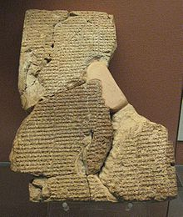
Cuneiform tablet with the Atra-Hasis Epic in the British Museum

Slide 18
Cuneiform tablet with the Atra-Hasis Epic in the British Museum - Wikipedia
Sumerian paradise is described as a garden in the myth of Atrahasis where lower rank deities (the Igigi) are put to work digging a watercourse by the more senior deities (the Annanuki).^{[86]}
When the gods, like man. Bore the labour, carried the load. The gods' load was great, the toil grievous, the trouble excessive. The great Annanuki, the Seven, Were making the Igigu undertake the toil.^{[87]}
The Igigi then rebel against the dictatorship of Enlil, setting fire to their tools and surrounding Enlil's great house by night. On hearing that toil on the irrigation channel is the reason for the disquiet, the Annanuki council decide to create man to carry out agricultural labour.^{[87]}

Slide 19
Ezekiel quote - a clue to the location of the Garden of Eden.
Behold, the Assyrian was a cedar in Lebanon with fair branches, and with a shadowing shroud, and of a high stature; and his top was among the thick boughs. The waters made him great, the deep set him up on high with her rivers running round about his plants, and sent out her little rivers unto all the trees of the field. Therefore his height was exalted above all the trees of the field, and his boughs were multiplied, and his branches became long because of the multitude of waters, when he shot forth. All the fowls of heaven made their nests in his boughs, and under his branches did all the beasts of the field bring forth their young, and under his shadow dwelt all great nations. Thus was he fair in his greatness, in the length of his branches: for his root was by great waters. The cedars in the garden of God could not hide him: the fir trees were not like his boughs, and the chestnut trees were not like his branches; nor any tree in the garden of God was like unto him in his beauty. I have made him fair by the multitude of his branches: so that all the trees of Eden, that were in the garden of God, envied him - Ezekiel 31:3-9 KJV)

Slide 20
In the Epic of Gilgamesh, the Cedar Forest was visited by Gilgamesh and Enkidu – Enkidu is said to have killed the giant Hawara, who guarded the Cedars for the Anannage – both spoke to the Keeper of the Gate at the entrance to the Enclosure (Garden of the Gods). Roman Emperor Hadrian brought in strict laws to protect the Lebanon Cedars.

Slide 21
Extracts from the Bible
The Bible itself lends further credence to Israel (or someplace nearby) as the location of the Garden of Eden. Cedar trees are mentioned elsewhere in the Bible as references to Lebanon (Judges 9:15, Psalms 29:5 & 104:16, Song of Solomon 5:15, Isaiah 2:13, Jeremiah 22:23 and more). In this passage the Bible says that the Assyrian was in Lebanon. From this we can infer that the Garden of God and the source of the rivers of the Garden was somewhere close to the land of Lebanon.

Slide 22
Mt Hermon Range – Lebanon Syria Border Mount Hermon was called Senir by the Amorites, Sirion by the Sidonians, Ba'al-Hermon by the Canaanites and also Mount Sion or Siyon in the bible.

Slide 23
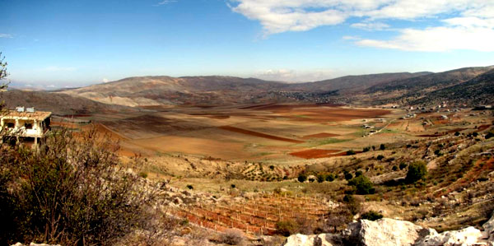
Panoranic View across the Rachaiya Basin, Southern Lebanon Taken during our November 2009 visit and Survey of the Site of the Garden of Eden - called Kharsag by the Sumerians Composite Photograph by Karl Guildford – Copyright Skyshot Ltd.

Slide 24
Extract from The Impact of Radio Carbon Dating on Old World Archaeology: Past Achievements and Future - O Bar-Yosef Peabody Museum, Department of Anthropology, Harvard University, Cambridge, Massachusetts 02138, USA.
Second, there is a general agreement on the identification of the Younger Dryas, whether in marine sediments, lake cores, or speleothems (Wright Jr 1993; Rossignol-Strick 1995; Hillman 1996; Landmann et al. 1996; Bar-Mathews et al. 1997, 1999; Lemcke and Sturm 1997; Fontugne et al. 1999; Frumkin et al. 1999).
The conditions prevailing during the Younger Dryas are crucial in interpreting the archaeological remains, and, unfortunately, the dating of this period in the Near East is not without difficulties.
According to the ice cores, the Younger Dryas lasted from 12.9 to 11.6 ka (Alley et al. 1993; Mayewski et al. 1996), while in the varve sequence of Lake Van in eastern Turkey (Lemcke and Sturm 1997), this cold and dry period was longer by around 800 years.

Slide 25
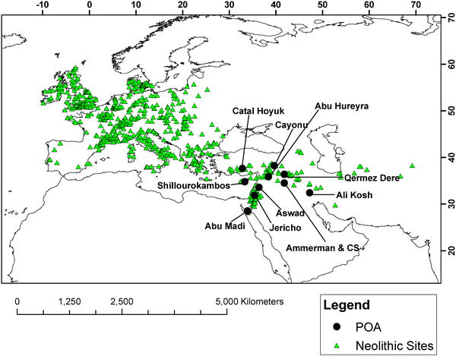
Ten Probable Centers of Origin of Agriculture – POA’s - 2007
Location of the 735 Archaeological Sites Used in the Analysis
From Tracing the Origin and Spread of Agriculture in Europe Ron Pinhasi, Joaquim Fort, Albert J. Ammerman.

Slide 26
Flow from the Rachaiya Basin (Aiha Plain) to the Hasbani River in red – Headwaters of the Jordan

Slide 27
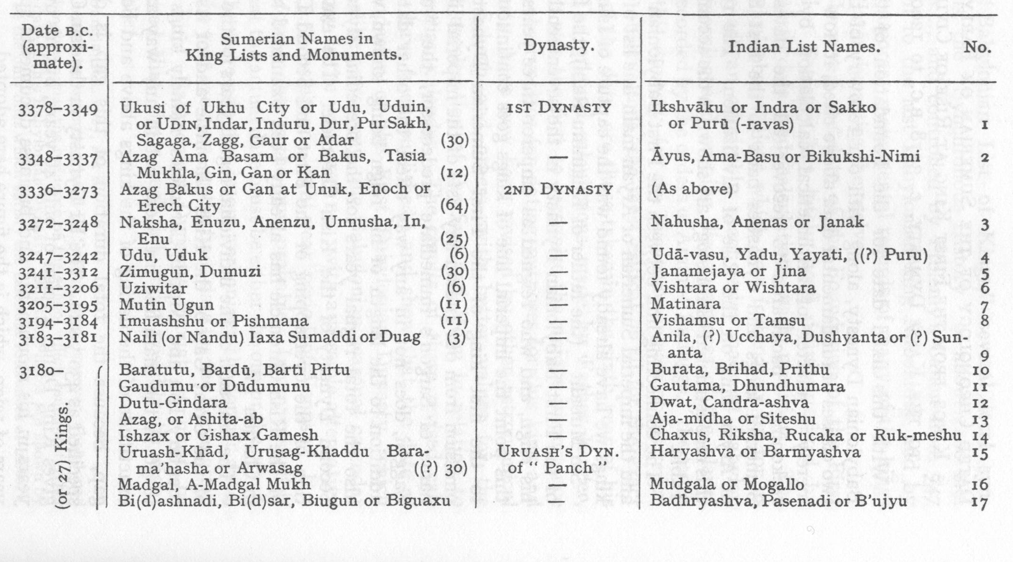
Dated Chronological List of Sumerian or Early Aryan Kings to Kassi Dynasty c. 1,200 BC Years of Reign are within brackets – L.A. Waddell

Slide 28
BA'ALBEK
An Akkadian tablet from some four thousand years ago states:
All we great Anunaki [Anannage] Decided together on a rule Anu and Addad would rule the Highlands I [Enlil] would rule the Lowlands
In this stanza, the Highlands and the Lowlands are relative terms. We know that Enlil, the Lord of Cultivation, ruled in Kharsag so that, here, the Lowlands refer to that irrigated plain as distinct from the surrounding mountains. The Highlands, therefore, were the higher parts of the Lebanon area. In these parts, today, there exist the magnificent ruins of Ba’albek to remind us of the almost incredible achievements of gods and men in times so remote that the mind has difficulty in comprehending the span of it.
These ruins comprise an architectural complex the description of which includes such superlatives as having columns among the tallest ever constructed on earth; the largest stone blocks ever used for any purpose; and the boldest architectural engineering feat ever carried out in the ancient world.
From the Shining Ones by Christian and Barbara Joy O’Brien

Slide 29
The End

